Slide 1
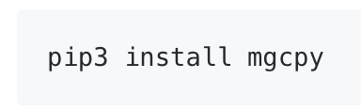
Task 2 (Satish): Implement MGC into the package
Last Week Accomplishments:
Extract Bear’s permutation test from DCorr into a common utility and use that to compute p-value in MGC and write tests.
For now, have just copied it, when Bear merges to development, will call that.
Compare Python MGC with R version and report the performance.
Write a master function in main.py that can call the different independence tests.
Fix bug in MGC test statistic computation and a few bugs in simulations.
Push mgcpy to PyPi.
Add a demo notebook for MGC

Slide 2
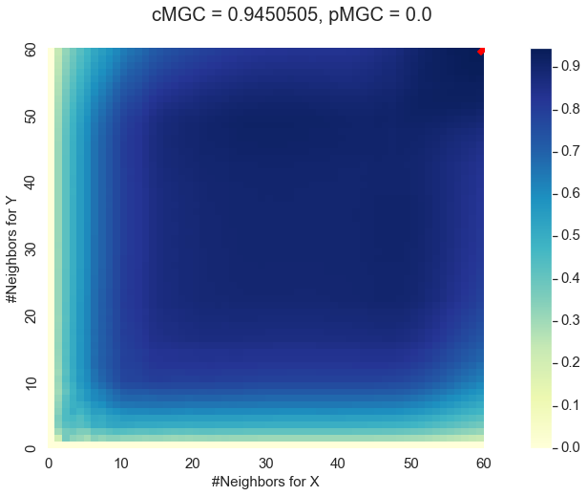
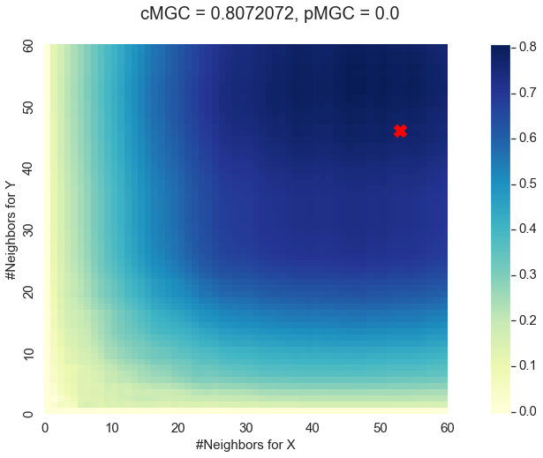
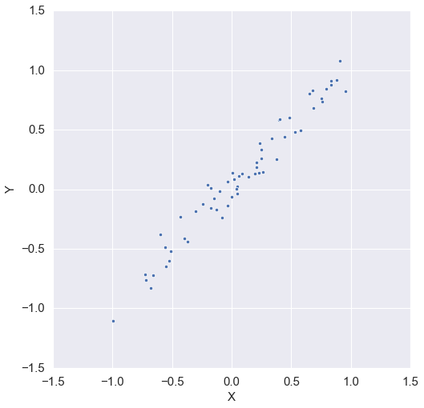
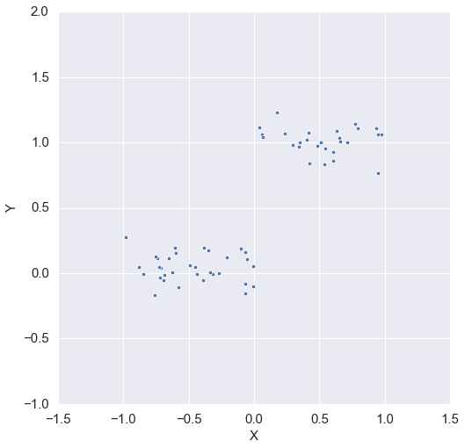
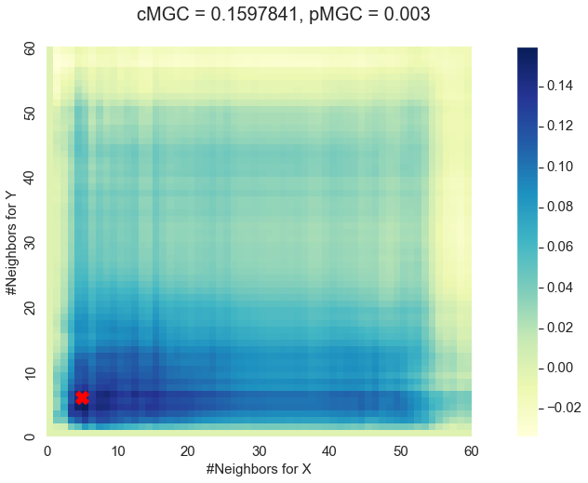
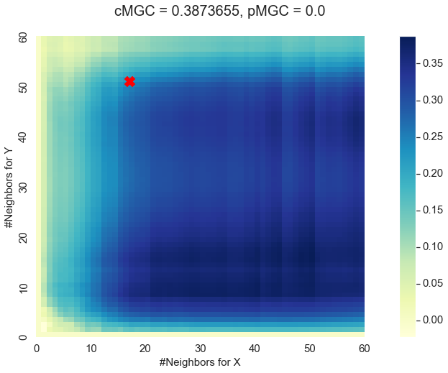
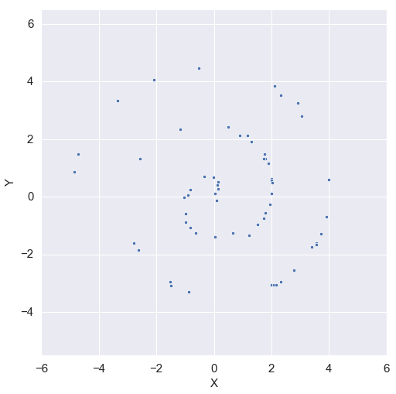
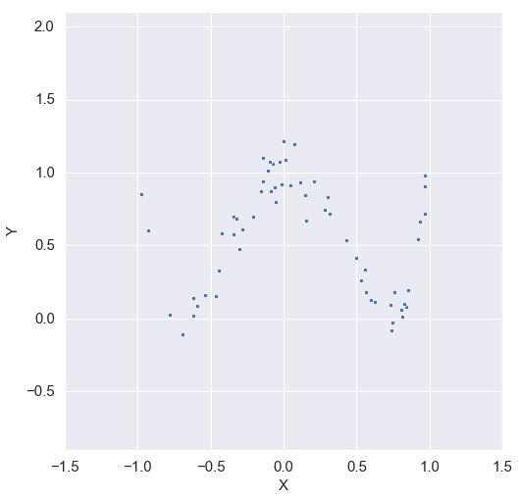
MGC Demo
Note: 60 samples, 1 dimension each, with noise of 0.1 (notebook)

Slide 3
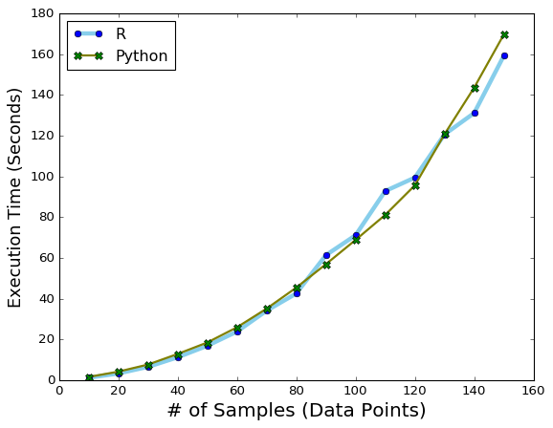
MGC performance comparison: Python vs R (notebook)
Data:
Linear data (simulated)
# of Samples: 10 to 150; steps: 10
1 D with noise: 0.1
Execution Time:
Modules used: timeit for Python and microbenchmark for R
Best of 5 trials
Result:
R version of MGC is mostly faster than the Python version
Effect is more pronounced as # of samples increases
Specs:
OS: macOS 10.14
CPU: 2.3 GHz (i5, dual core)
RAM: 8GB, 2133MHz

Slide 4
Stuff to do this week
Look where Python MGC is slowing down and try to improve its performance
Study about fastMGC and start exploring the MATLAB code, and port some initial code into Python
Get link to fastMGC paper from jovo?

